Slide 1

CS 533 INTRO TO DATA SCIENCE
Michael Ekstrand

Slide 2
WHAT IS CLASSIFICATION?

Slide 3

Learning Outcomes (Week)
Predict binary outcomes or classes for observed instances
Evaluate the accuracy of a classification model
Use Scikit-Learn for predictive modeling
Photo by Photos Hobby on Unsplash

Slide 4
Outcome Variables
Continuous — regression
Categorical — classification
Two-level category (or ordinal) is binary classification
Multi-level ordinal — ordinal regression
Multi-level categorical — multi-class classification
Sometimes we’ll simplify to binary problem!
“mostly fresh”: % Fresh greater than 50%

Slide 5


Groups and Classes
Inference
What is the difference?
t-tests etc.
Classification
Where does a new animal go?
Photos by The Lucky Neko and Jametlene Reskp on Unsplash

Slide 6
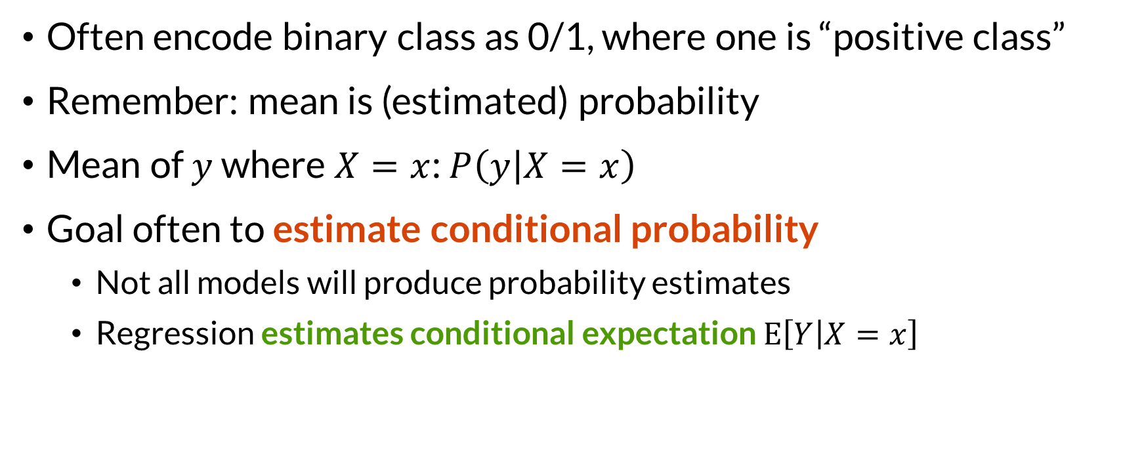

Classification and Probability
Often encode binary class as 0/1, where one is “positive class”
Remember: mean is (estimated) probability
Mean of $y$ where $X=x$: $P\left(y | X=x\right)$
Goal often to estimate conditional probability
Not all models will produce probability estimates
Regression estimates conditional expectation $E\left[Y | X=x\right]$

Slide 7

Wrapping Up
Classification allows us to predict discrete outcome variables.
There are many models. We will start with linear ones.
Photo by Adam Nieścioruk on Unsplash

